Slide 1
The national importance of consuming whole grain products
Nacionalni pomen uživanja polnozrnatih izdelkov
Dr. Marjeta Recek, Ministry of health
29th March 2022

Slide 2
National Programme on Nutrition and Health Enhancing Physical Activitiy 2015-2025
Vision = to create an environment that offers individuals healthy food choices and stimulates PA
better health and quality of life
Notes:
In order to tackle obesity Slovenia seven years ago adopted the comprehensive multisectoral and multistakeholder National Program which linked nutrition and phisical activity.
VISION of the programme is good eating and physical activity habits for whole population and that a healthy choice is the easiest choice.

Slide 3
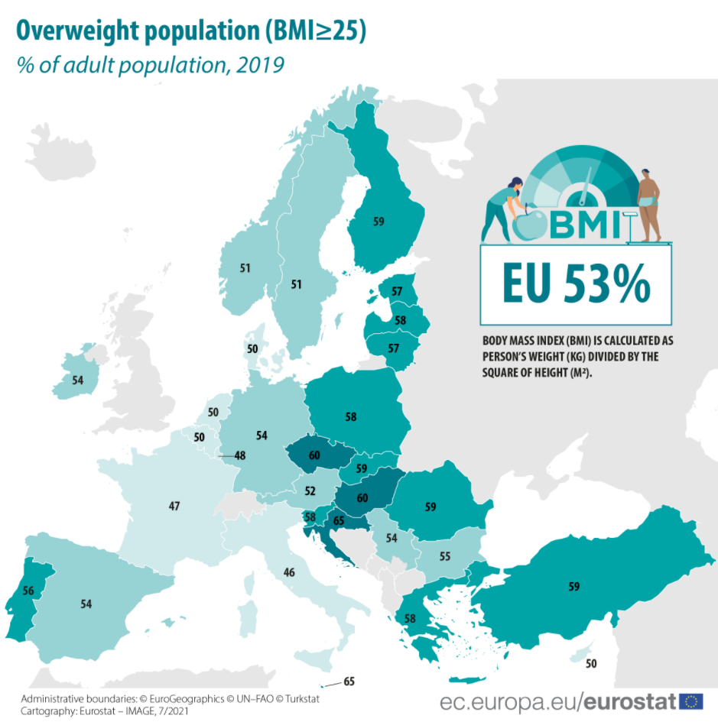
Slovenia 58%
Notes:
Just quick look at the obesity data. This picture shows adults obesity among EU countries.
As seen from the slide, Slovenia is above the average of the EU countries and 58% of the adult population of Slovenia have a body weight higher than recommended.

Slide 4
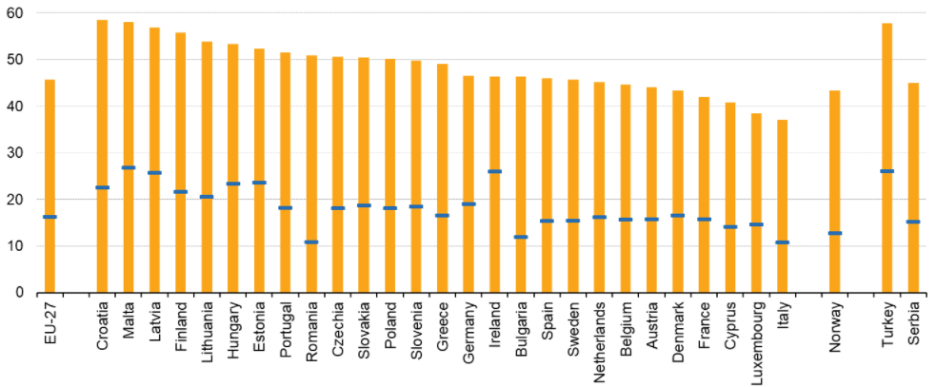
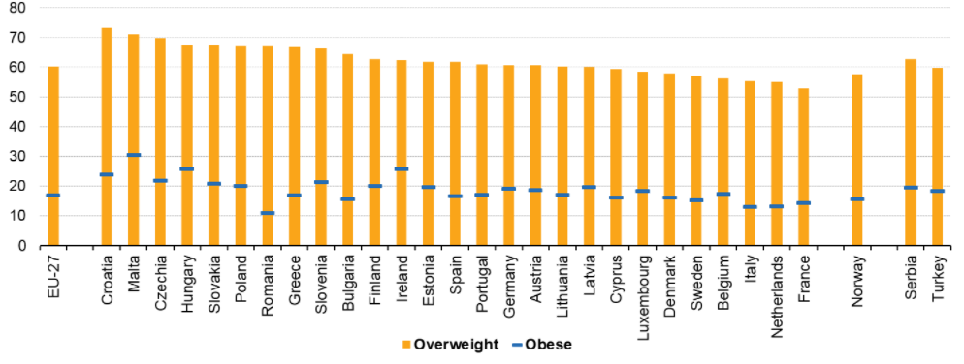
Overweight and obese 2019
woman
men
male
Notes:
In terms of gender, we see that obesity and overweight in Slovenia are higher among men than women.

Slide 5
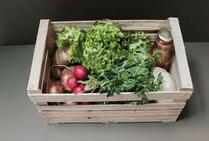
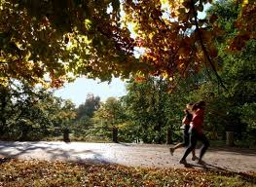
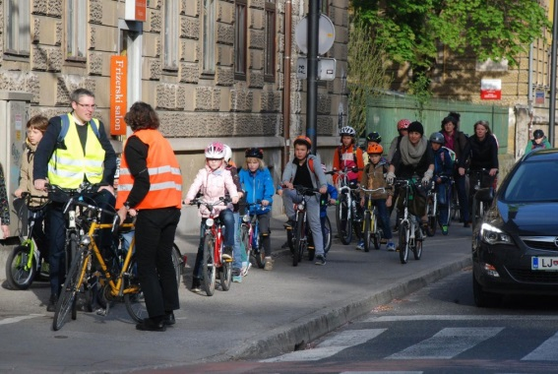
The aim of the National Programme
Empower people to be and stay healthy
Notes:
The aim of the National Programme is empower people to be and stay healthy
In order to follow this aim it is important:
To create a healthy environment – means affordable healthy food for all, availablefresh locally produced food …
environment that stimulates physical activity (cycling to school, business, green area for walking etc.)
It is evident we need a lot of partners, non-governmental and governmental.

Slide 6
Priority areas
Nutrition
Sustainable
Local (food culture)
Recommendations
Tourism and services
Accessibility
Food industry
Physical activity
EDUCATION AND AWARENESS
Notes:
The National program set priority areas
Nutrition:
Ensuring healthy and safe food from local and sutainable production;
Nutrition aligned with recommendations and guidelines
Increasing healthy foods in tourism and services
Accessibility of healthy choices for socially deprived and vulnerable groups
Food industry: encourage and support healthy food production + transparent labelling and responsible marketing of food which enables consumers to easily recognize healthy choices
Physical activity
Last but not least : supporting physical activity
All this is only viable thru wide education and awareness programs.

Slide 7
Key is in cooperation
Local and sustainable food production
Tourism (active, healthy and green)
Spatial
planning
Health sector
Education
Sustainable mobility
Sociale
wellfare
Mass media
Sport
Notes:
Awareness comes only with cooperation – I did not want to present overcrowded slide, but each inhabitant should be involved in taking care for his or her own health.
To achieve this the only way is to bring stakeholders from different sectors on board and to work with them on a daily basis.
In this way, we are implementing the health in all policies approach.

Slide 8
Notes:
The Ministry of Health has one of the cruical roles in coordination of the national program
The program has over 30 stakeholders which are active in its implementation.
DOBER TEK Slovenia = Bon Appetit & wish you a good run

Slide 9
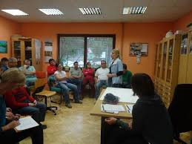
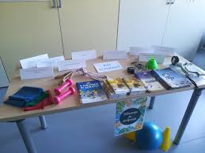
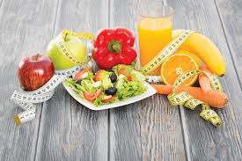
Strategy meets people
Role of health care
workshops in Health care centers
introduction of multidciplinary
approach
school of clinical nutrition
Notes:
There is also the important role of the health sector in preventive actions and promoting lifestyle.
in the following slide you can see
-workshops in Health care centers are going on where people learn about healthy choices
-in primary health care it was introduced a multidciplinary approach; where a dietician in the kinesiologist also joins a team of doctors in nurses
-school of clinical nutrition is going on to build knowlege capacity

Slide 10
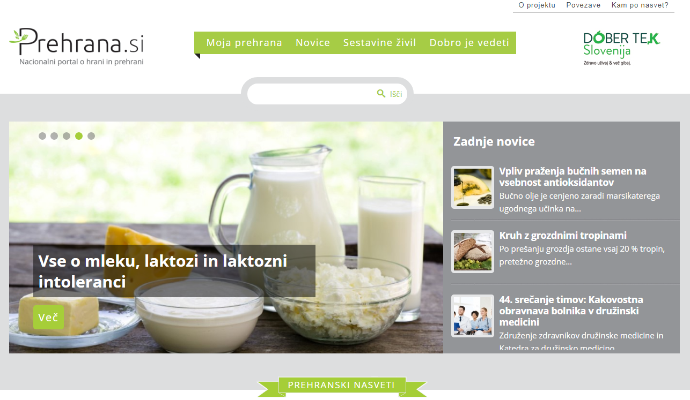
Strategy meets people
Healthy choices in schools
Advertising to children on TV
www.prehrana.si
Verified food information portal
Notes:
Healthy nutrition in school is very important priority in Slovenia. This is why many important activities are taking place.
Ministry of health and NIPH in cooperation with WHO developed guidelines for advertising food in children’s TV programmes
Since the web is also a source of biased information verified food information web portal has been developed.

Slide 11
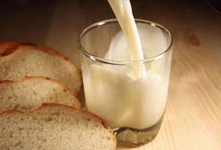
Intersectoral cooperation
Cooperation with the food industry and trade
Safe, healthy and locally produced food
Promoting the physical activity
Notes:
In the following slide you can see more examples of good practices that were iniciated in before mentioned national programme:
The second emphesasis: Also fresh and locally produced food is promoting - Cooperation with agricultural sector.
The third shows promoting regular PA and active way of live where we cooperate with sport and infrastructure sector.

Slide 12
Intersectoral cooperation
Health-beneficial food products and industry participation
Sugar reduction: beverages, dairy products, bakery pastries,
Salt reduction: bakery
Industry commitments regarding nutrients:
Beverage sector (sugar), dairy (sugar), bakery sector (sugar, salt, WG)
Notes:
Let me explain the role of the ministry, in addition to preparing and coordinating the implementation of the national program.
In cooperation with the Chamber of Commerce and the merchants, activities regarding food reformulations are going on. Less salt, less sugar, transfats. Voluntary of different sectors: beverages, dairy sector and bakery
By implementing action plans, we co-finance programs to improve the nutritional composition of foods.
In recent years, industry commitments have been made to gradually reduce certain nutrients such as sugar, salt and increase whole grains.
We are aware that there is a need to increase interest in whole grains on both sides, producers as well as consumers. Therefore, we also enable the existence of the national nutrition website prehrana.si with credible and understandable information to the consumer.

Slide 13
Intersectoral cooperation
Activities at retailers – less sugar, less salt
Activities at caterers – the right choice
practical catering training for student meals providers,
updating dietary recommendations for student nutrition providers
awarding „The right choice symbol“ for nutritional balanced meal,
increasing student awareness
Notes:
Some retailers have already recognized food reformulation as an opportunity and a contribution to improving the health of the population. They reduce sugar and salt in the products of their own brands. Increase fiber in bread…
Activities with caterers have been going on for several years.
We are working to improve the nutritional quality of student lunches.
There will be practical training, updating of guidelines for preparing meals, awarding the symbol of The right choice, and raising awareness of students..

Slide 14
Where are we today?
ACHIEVEMENTS
Fruit and vegetables
Breakfast
Food quality
Physical acitivity
Overweight children
Notes:
We have already noted positive trends, especially in areas where the activities started in the past nutrition policy.
Better eating habits can be observed. Obesity and overweight of children started to decline in 2011.
The success of the national program is already being reflected in certain areas.
We can see that more people are having breakfast regularly. We also drink less sugary drinks.
The latter was strongly influenced by media activity in 2014.
We also believe that the media could play an important role in the joint efforts for whole grain products.

Slide 15
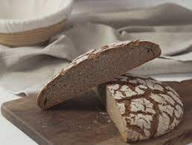
National program: dietary fiber
need to significantly increase a dietary intake of at least 30 g of dietary fiber per day.
data from 2009:
only 27% of the population occasionally eats wholemeal bread and
31% never.
Notes:
The National Program on Nutrition and Physical Activity for Health 2015-2025, Eat Healthy and Be Active points out that the percentage of the population consuming whole grains needs to be significantly increased in order to achieve a dietary intake of at least 30 g of dietary fiber per day.
Already at the time of the adoption of the program, data showed that only 27% of the population occasionally eats wholemeal bread, and 31% never.

Slide 16
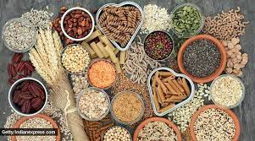
The impact of dietary fiber on health
The key sources of dietary fiber:
vegetables and legumes,
fruits,
whole grains.
beneficial effects on health;
on digestion (colorectal cancer),
reducing the risk of cardiovascular disease,
type 2 diabetes.
Notes:
To improve quality of food supplied to people it is also important to increase using of dietary fiber.
The key sources of dietary fiber: in the diet are vegetables and legumes, fruits and whole grains.
Intake of fiber has many proven beneficial effects on health:
on digestion (colorectal cancer),
reducing the risk of cardiovascular disease,
type 2 diabetes.

Slide 17
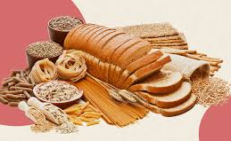
National data: dietary fibre
research Si.Menu (2019):
90% of the population consumes less than the recommended 30 g of dietary fiber per day
Average intakes were significantly lower - around 20 grams
Since regular inclusion of foods based on whole grains in the daily diet contributes significantly to the dietary intake of fiber, the goal of the national program is obvious - to increase the offer and the consumption of wholegrain products.
Notes:
In 2019, by another nationally representative dietary research Si.Menu, intake of dietary fiber in the population of Slovenia is still not sufficient-
90% of the population consumes less than the recommended 30 g of dietary fiber per day, only around 10 % currently meet the daily target
Slovenians consume around 20 grams fiber per day , significantly under the recommended amount of 30 g
Since regular inclusion of foods based on whole grains in the daily diet contributes significantly to the dietary intake of fiber, the goal of the national program is obvious - to increase the offer and the consumption of wholegrain products.
Danish had excellent results when completed the Whole grain partnership.

Slide 18
Can a public private partnership help to increase WGs consumption?
Is it possible to have such success as in Denmark in Slovenia too?
A European Action on Whole Grain Partnerships - 3 years (nov. 2019)
Objective - to transfer the Danish model of best practice for whole grain partnerships (WGP) with the aim of increasing consumption of whole grains and products.
Notes:
Can a public private partnership help to increase WGs consumption? Is it possible to have such success as in Denmark in Slovenia too?
Danish good experiences with wholegrain partnership and results regarding fiber intake on a population level are like a hot buns.
In less than a decade, the average WG intake of Danes increased from 36 to 82 g/day. In a mean time (2004) because of popularity low carb- high fat diet, a declination was observed. Today 50% of Danes eat the recommended intake of 75 g of WG per day. This is a really great success.
By the way, our national recommendations are still 30 grams of fiber. To be realistic, the consumption of more 30 grams per day would be a success for Slovenia.

Slide 19
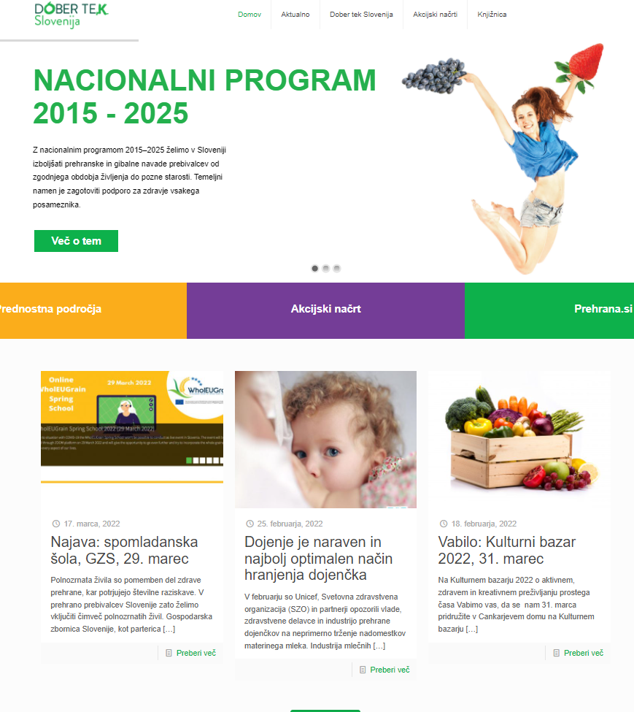
home page of the national program,www.dobertekslovenija.si
communication platform
brand DOBER TEK Slovenia
Information on programs and stakeholders
Notes:
Information on the programs, the action plan and other relevant information for the implementation of the program is available on the DOBER TEK Slovenija platform.
The single platform includes all relevant stakeholders and enables efficient data exchange.
As you may have noticed, we also posted the spring school announcement on the portal.

Slide 20
Thank you for your attention

